Slide 1
Week 11
Data visualizations, UI/ux

Slide 2
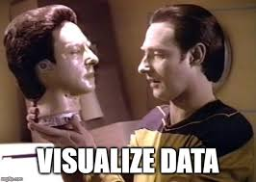
What are data visualizations
Data Visualization is a way to show data in an image of some variety
This could include things, such as pie charts, or bar graphs, or other types of plotted data
This could also include things like infographics, which are very popular online.
We can even consider animations a type of data visualization
The goal is to present data in an easy to understand format without losing the important points
Most people prefer some variety of data visualization to raw data because they are easier to understand

Slide 3
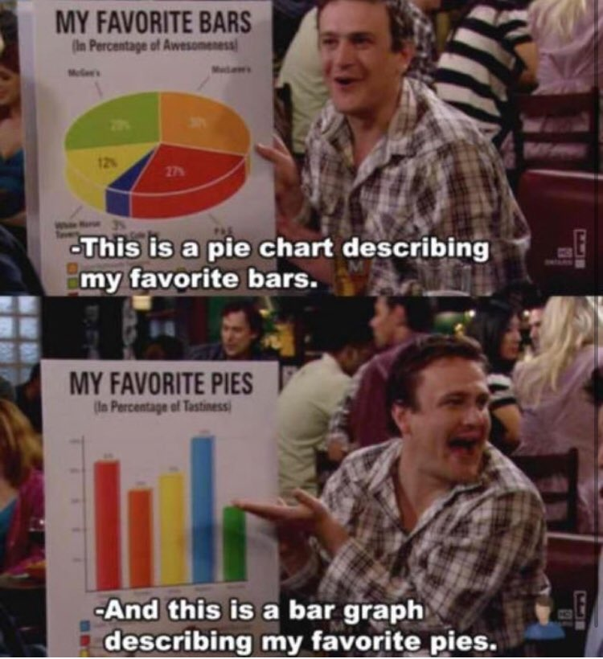
Why we want to use data visualization
Data visualizations, if done well, can communicate our data to others in ways they can understand faster and better
Just showing raw data to most people is going to be tough because it's hard to see the patterns at a glace
Showing the patterns can help us illustrate our data analysis work or just data in ways lists of numbers can't
There are several ways to show data including charts, graphs, plots, but it's important to know what you're picking and why to make it a good visualization
One expert in the field, Edward Tufte, has come up with criteria, we'll use his because he's considered one of the leading authorities on data visualization at this time

Slide 4
Criteria to create good visualizations
Excellence – Try to make your visualization offer the most bang for your buck. Don't make it more complex than it needs to be. “the greatest number of ideas, in the shortest time, using the least amount of ink, in the smallest space.”
Integrity – You need accurate data that is clearly labelled and not ambiguous. Don't try to mislead people with your visualizations
Maximizing the Data-Ink Ratio – Pay attention to what is required vs what is used, don't add things to add things, everything should be valuable on your visualizations
Aesthetic Elegance – Simplicity can be more powerful then clutter, complexity isn't always required

Slide 5
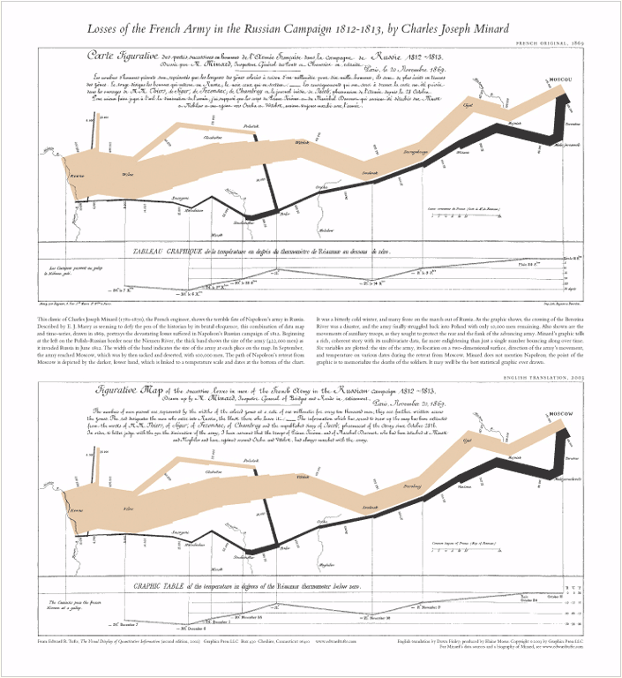
Example of a Good Data visualization
Tufte says that a map by Charles Joseph Minard is the best statistical graph ever drawn
https://www.edwardtufte.com/tufte/posters

Slide 6
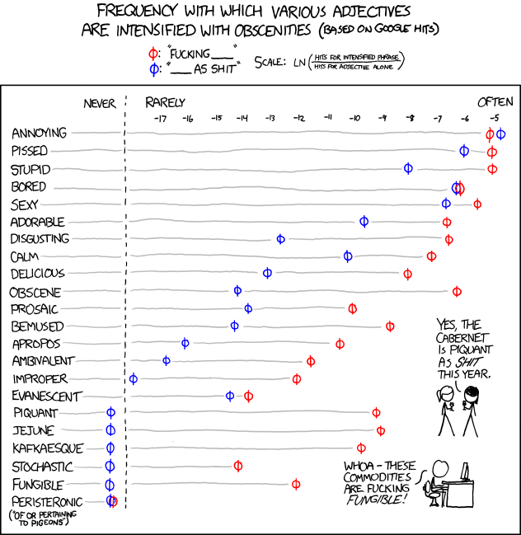
More current examples
https://informationisbeautiful.net/
Example: Buddhism principals https://informationisbeautiful.net/visualizations/buddhism-explained-key-beliefs-samsara-nirvana-dependent-origination-enlightenment-jhanas/
Example: Award Winners https://www.informationisbeautifulawards.com/news/593-information-is-beautiful-awards-2022-the-winners
How to choose which chart to use? https://www.atlassian.com/data/charts/how-to-choose-data-visualization
https://xkcd.com/798/

Slide 7
What makes a bad visualization?
Visualizations that mislead the viewer, either on purpose or by accident
Hiding relevant data, or inaccurately representing data by changing things like scale and proportion, where the chart starts/ends are usually trying to falsely lead you somewhere
Showing too much data to confuse the viewer either obviously like a lot of 3D graphs, or more subtly to give the impression of well thought out analysis when in reality it's trying to hide things
Lack of context, labels, or any way to tell what the visualization is about and why it was made
Using the right data, but in confusing ways to try and lead the viewer into thinking you're saying one thing but you really mean another

Slide 8
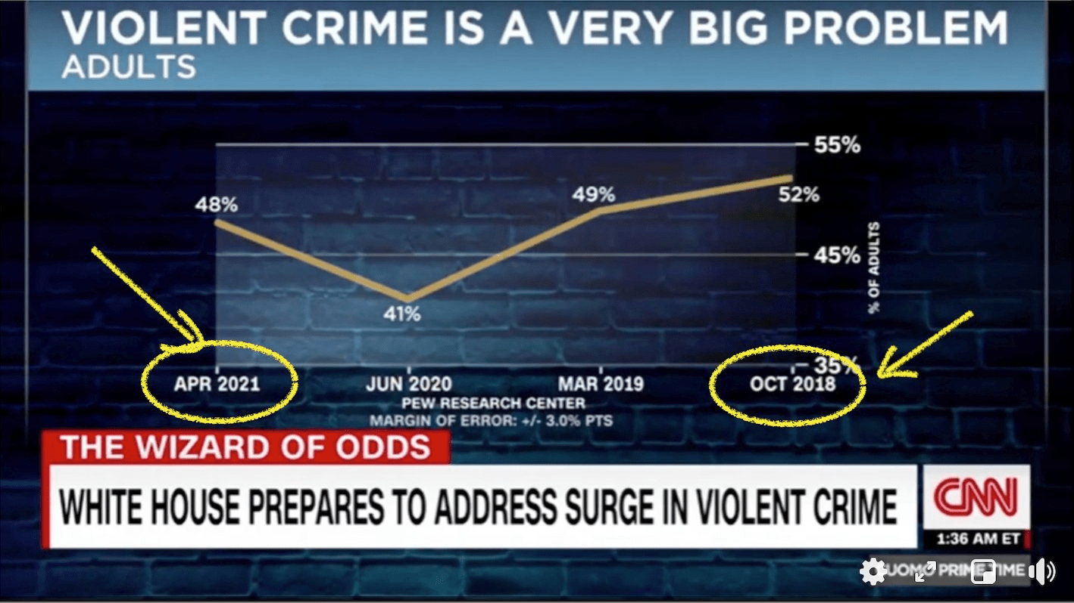
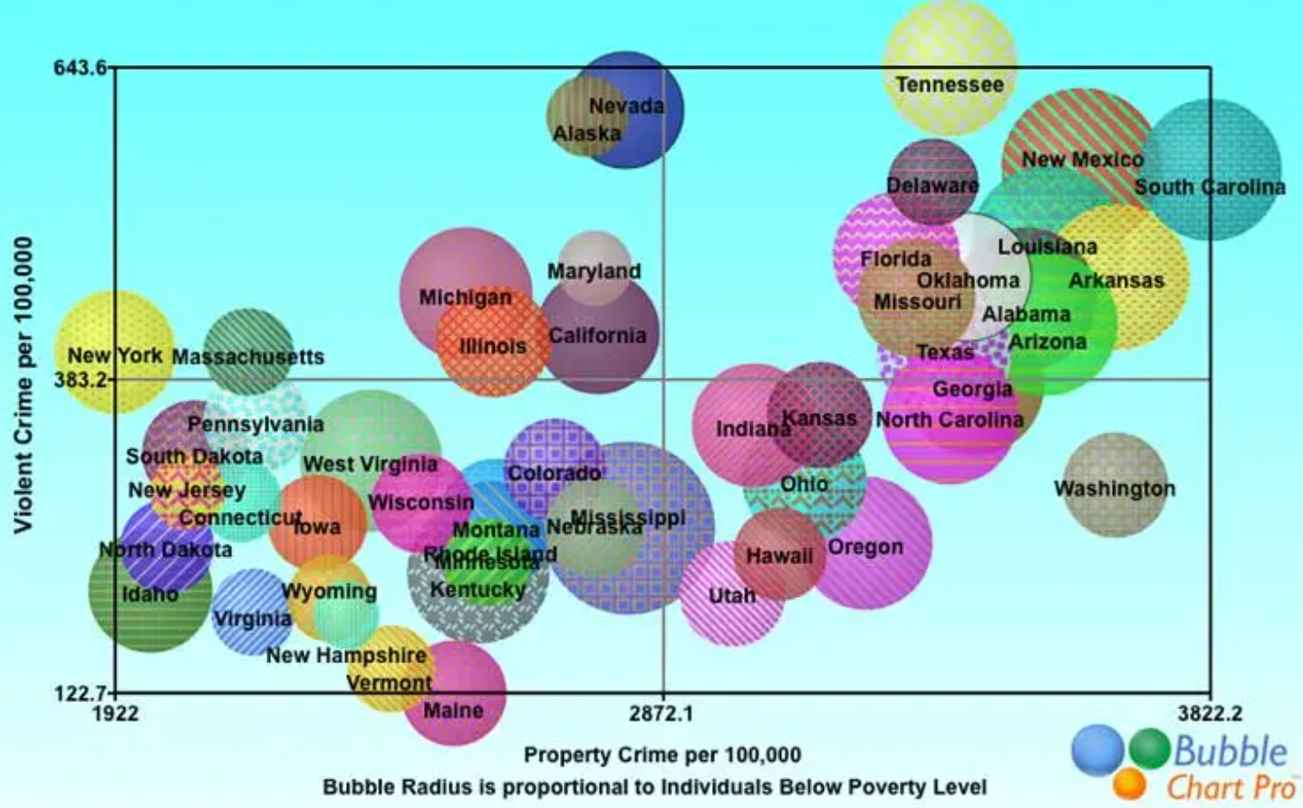
Examples of bad data visualization
https://viz.wtf/
https://www.reddit.com/r/dataisugly/
Misleading graphs
Too much Data

Slide 9
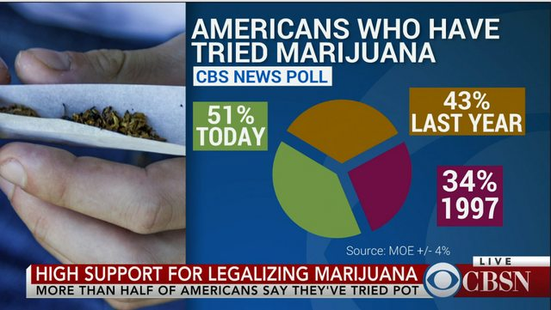
Why people might choose a bad visualization on purpose
Manipulation
Example: image shows the percentage of Americans who have tried marijuana in three different years
Is the chart showing 1 or 2?
All the people participating in the survey tried marijuana.
How many tried pot in which year
Based on first glance, what did you think this was showing?

Slide 10
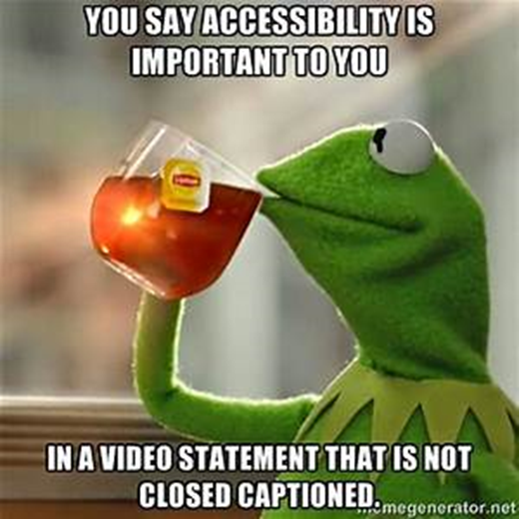
What is accessibility?
Making sure everyone has the same ability to understand and engage with materials
https://aem.cast.org/get-started/defining-accessibility
This can be for data visualizations, UI/UX or even just the world around us
This can be a tough thing to do because there can be a wide variety of things that keeps something inaccessible. Some questions we can ask are
To whom is it accessible
Under what conditions?
For which tasks?

Slide 11
Data visualizations and accessibility
Data visualizations can be tough because of everything from labelling issues, to colour or colour contrast, to lack of alt text
Accessibility should be baked in to what you're doing, not seen as an after thought
Keeping your visualizations simple can help because they can be easier to describe and offer alternates for
Being mindful of colours and contrast is helpful for both text and images. If someone can't see colours, does your visualization still convey your meaning? If not, can you change it so it does?
Think about offering different formats so that it's easier for everyone to understand what you're trying to share
https://accessibility.huit.harvard.edu/data-viz-charts-graphs

